Slide 1
Load balancer
Creating a two tier load balancer application for showcasing use of internal and external load balancer

Slide 2
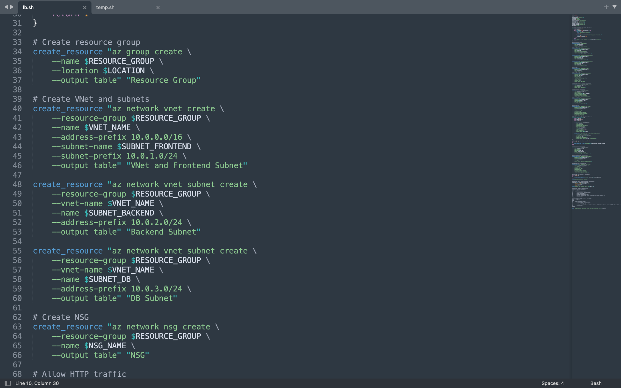
Using the script in the github you can provision all the things needed for This two tier application

Slide 3
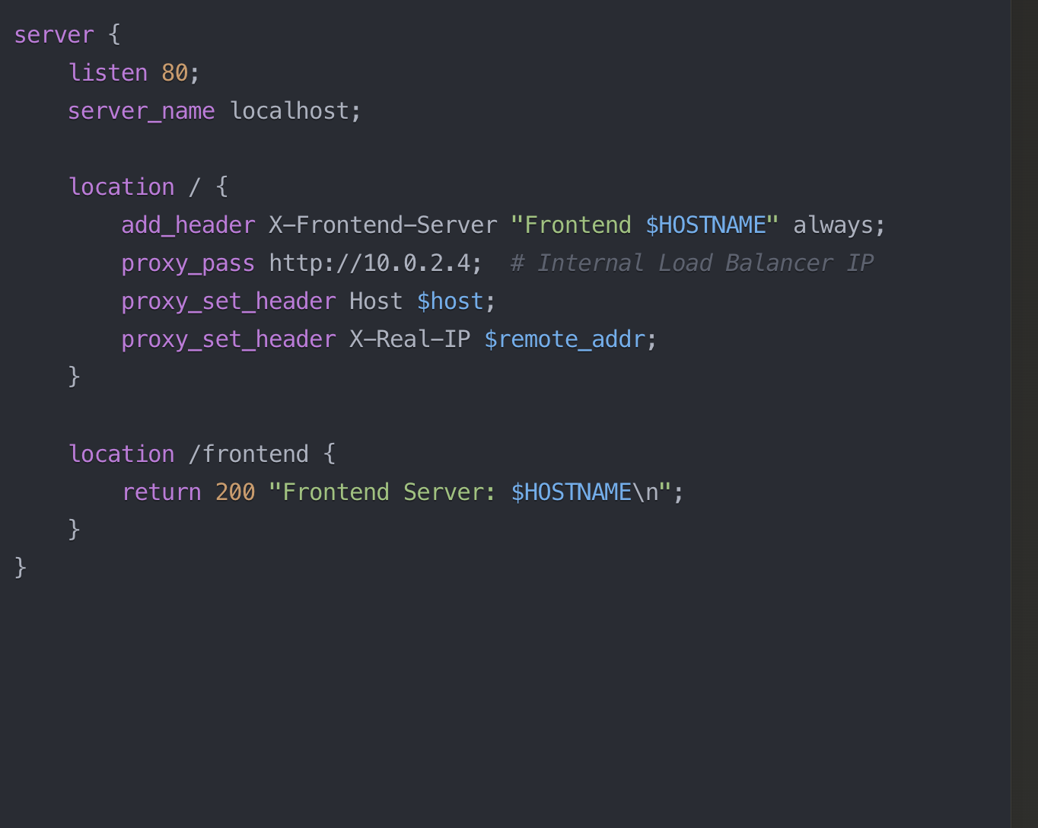
Nginx for setting up proxy at external vm

Slide 4
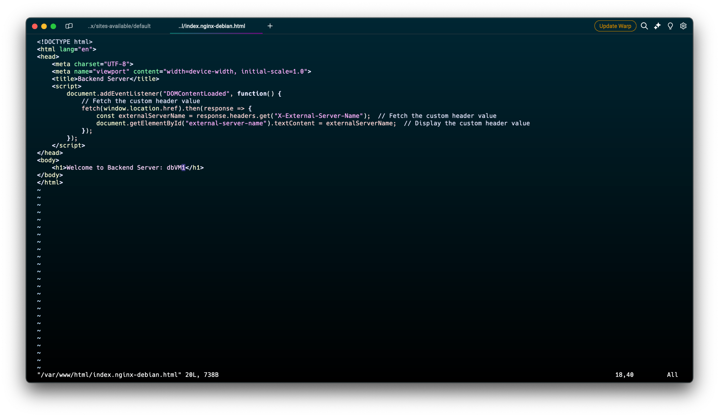
Html for internal vm

Slide 5
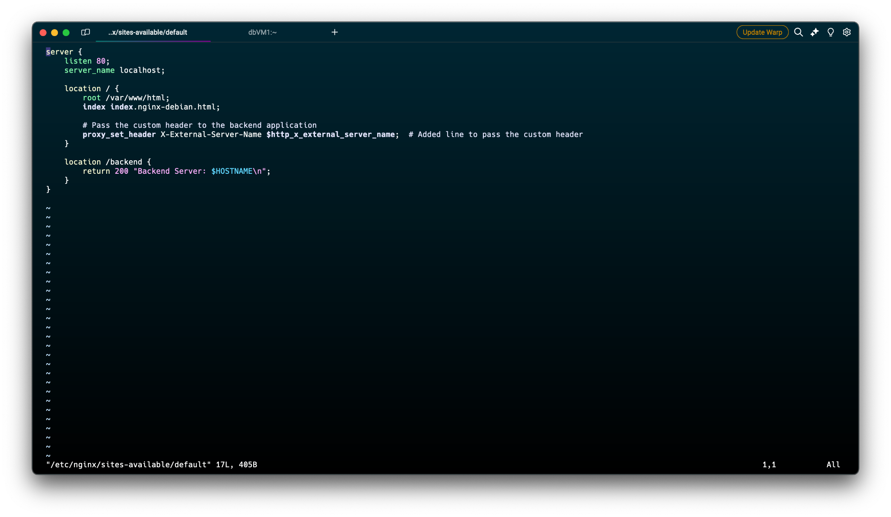
Nginx file for internal vms

Slide 6
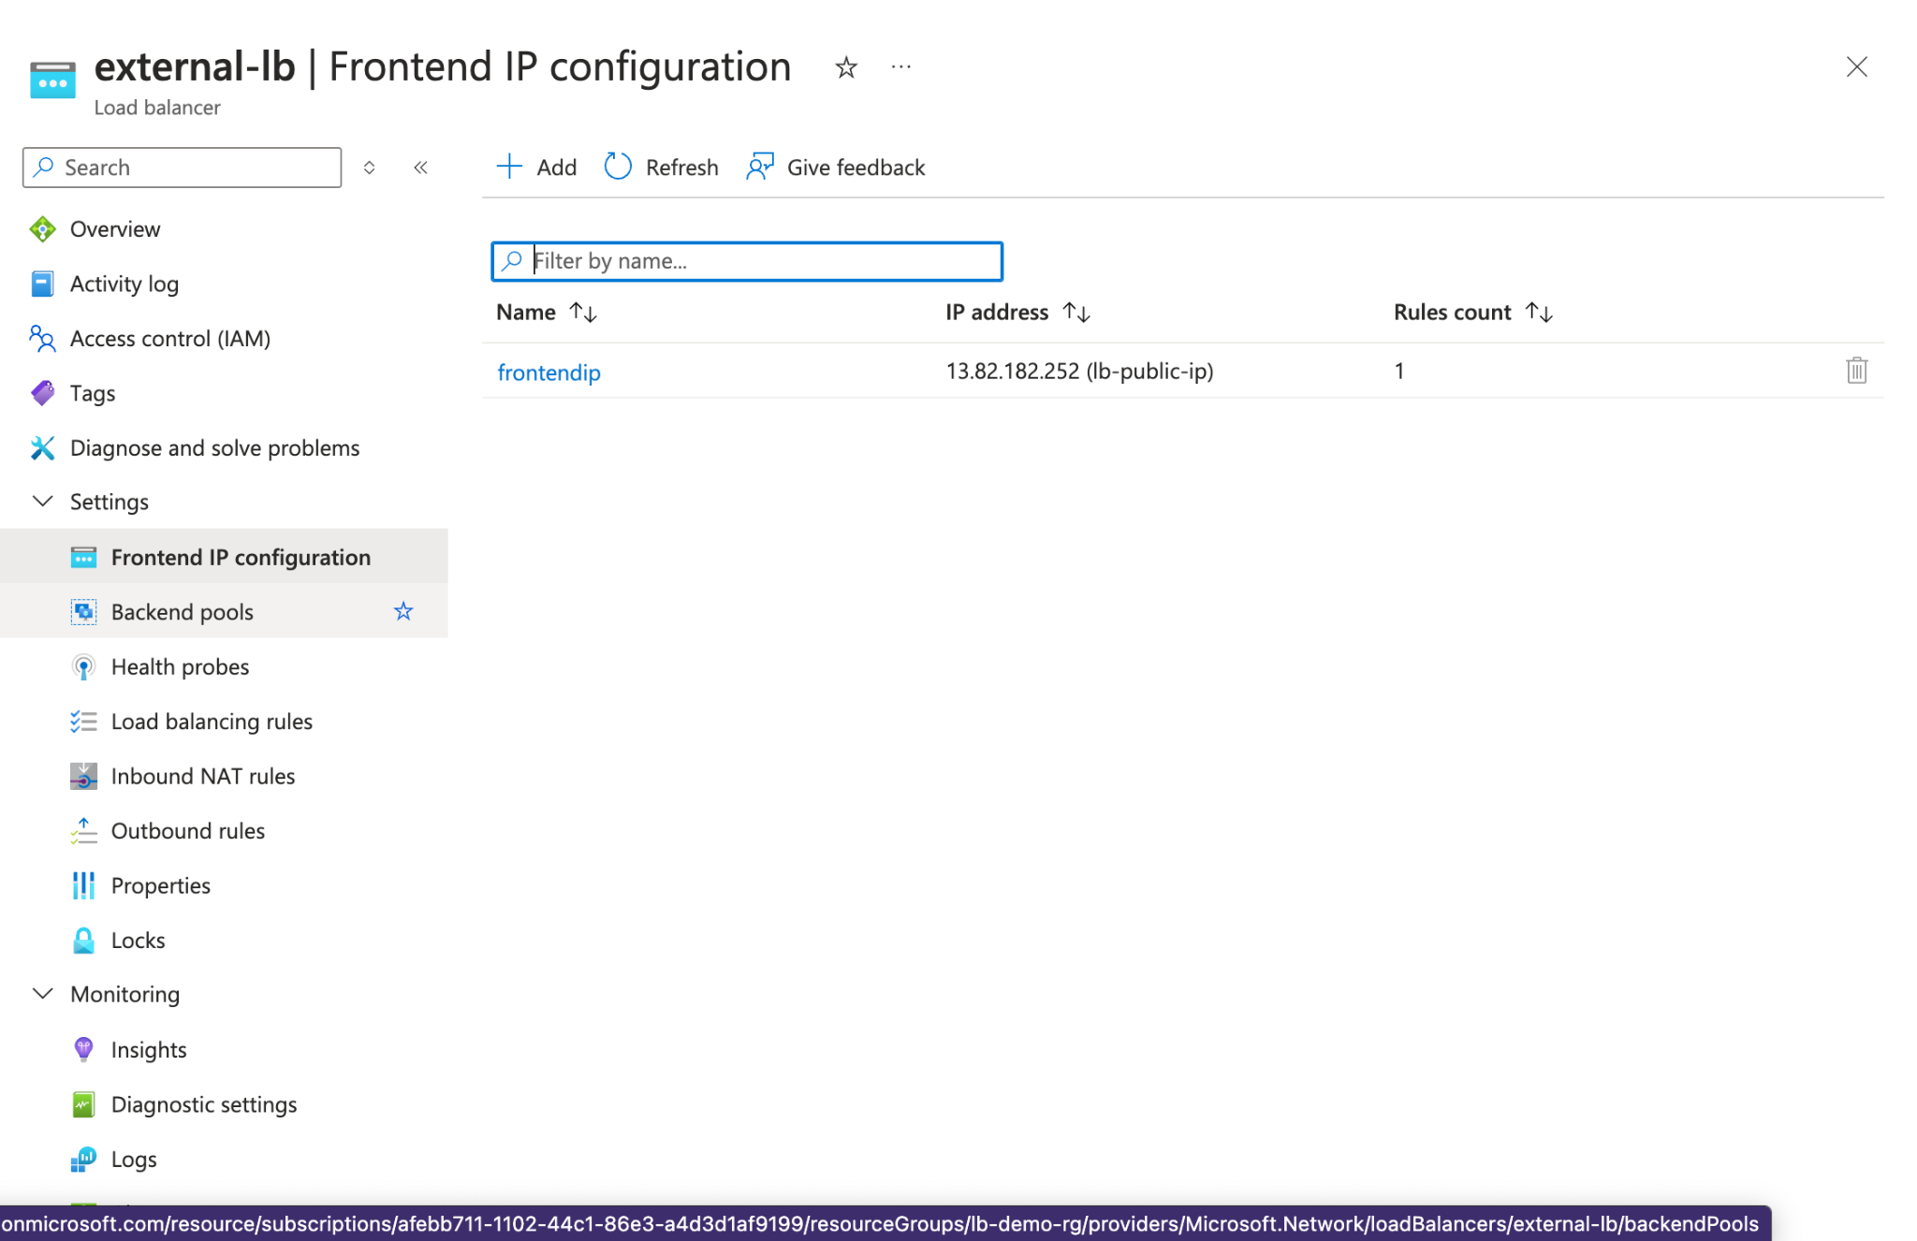
External load balancer ip

Slide 7
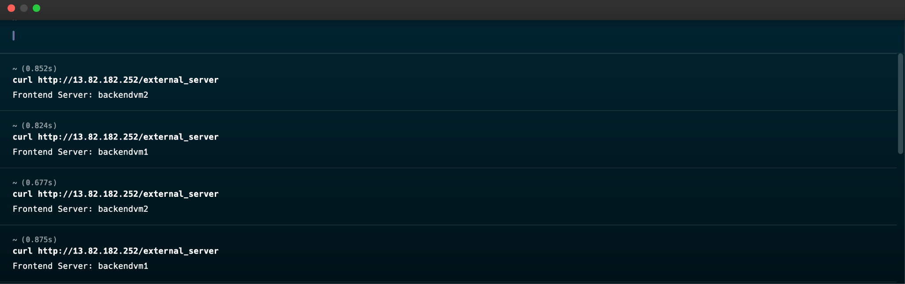
Accessing external vm for checking if working or not

Slide 8
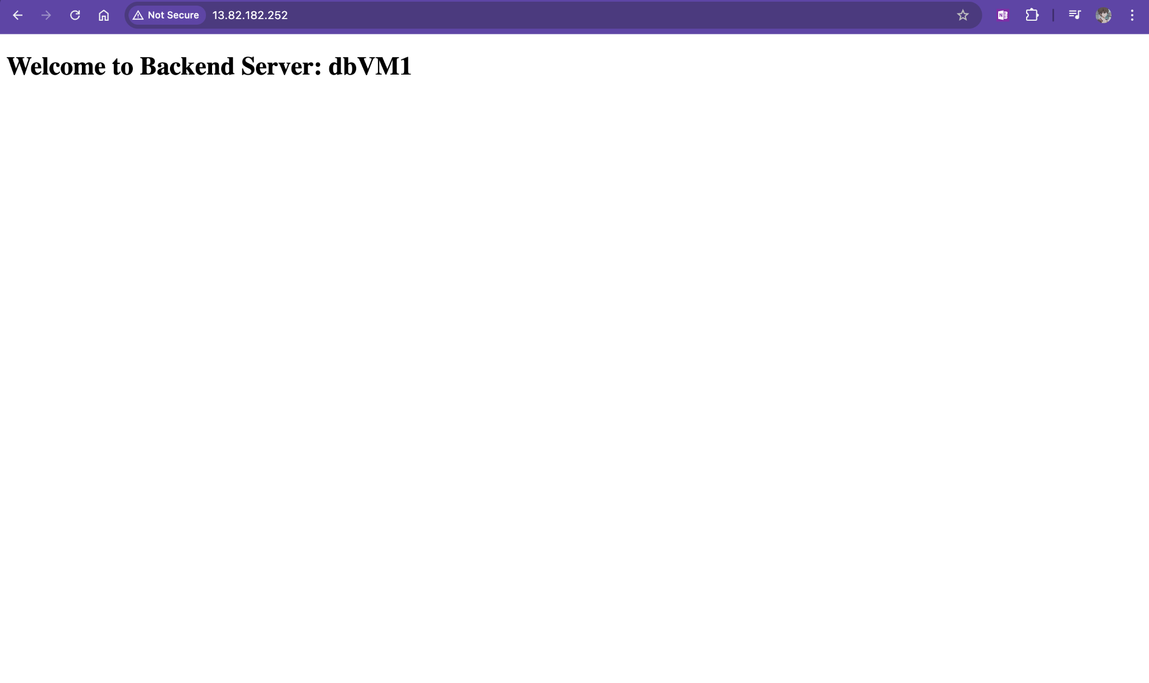
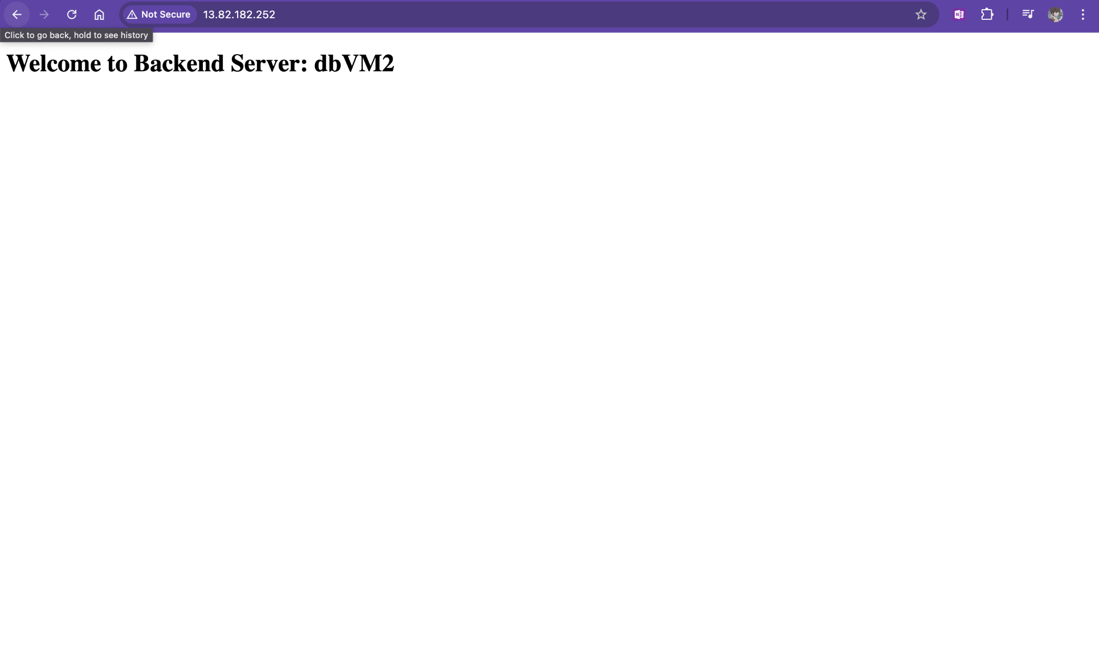
Demonstration of working of both internal vm inside internal load balancer

Slide 9
THank you

